Slide 1
Psalm 78: 5- 7 (NLT)
5
For he issued his laws to Jacob;
he gave his instructions to Israel.
He commanded our ancestors
to teach them to their children,
6
so the next generation might know them—
even the children not yet born—
and they in turn will teach their own children.
7
So each generation should set its hope anew on God,
not forgetting his glorious miracles
and obeying his commands.

Slide 2
Tony Lyon
27/6/2021
LEARNING LESSONS OF FAITH FROM THOSE WHO HAVE GONE BEFORE

Slide 4
The God of the Second Chance
Samson
Israel again did evil in God’s sight
So the Lord handed them over to the Philistines
Who oppressed them for 40 years [Judges 13:1]
The Lord heard their cries
He will begin to rescue Israel from the Philistines [13:5c]

Slide 5
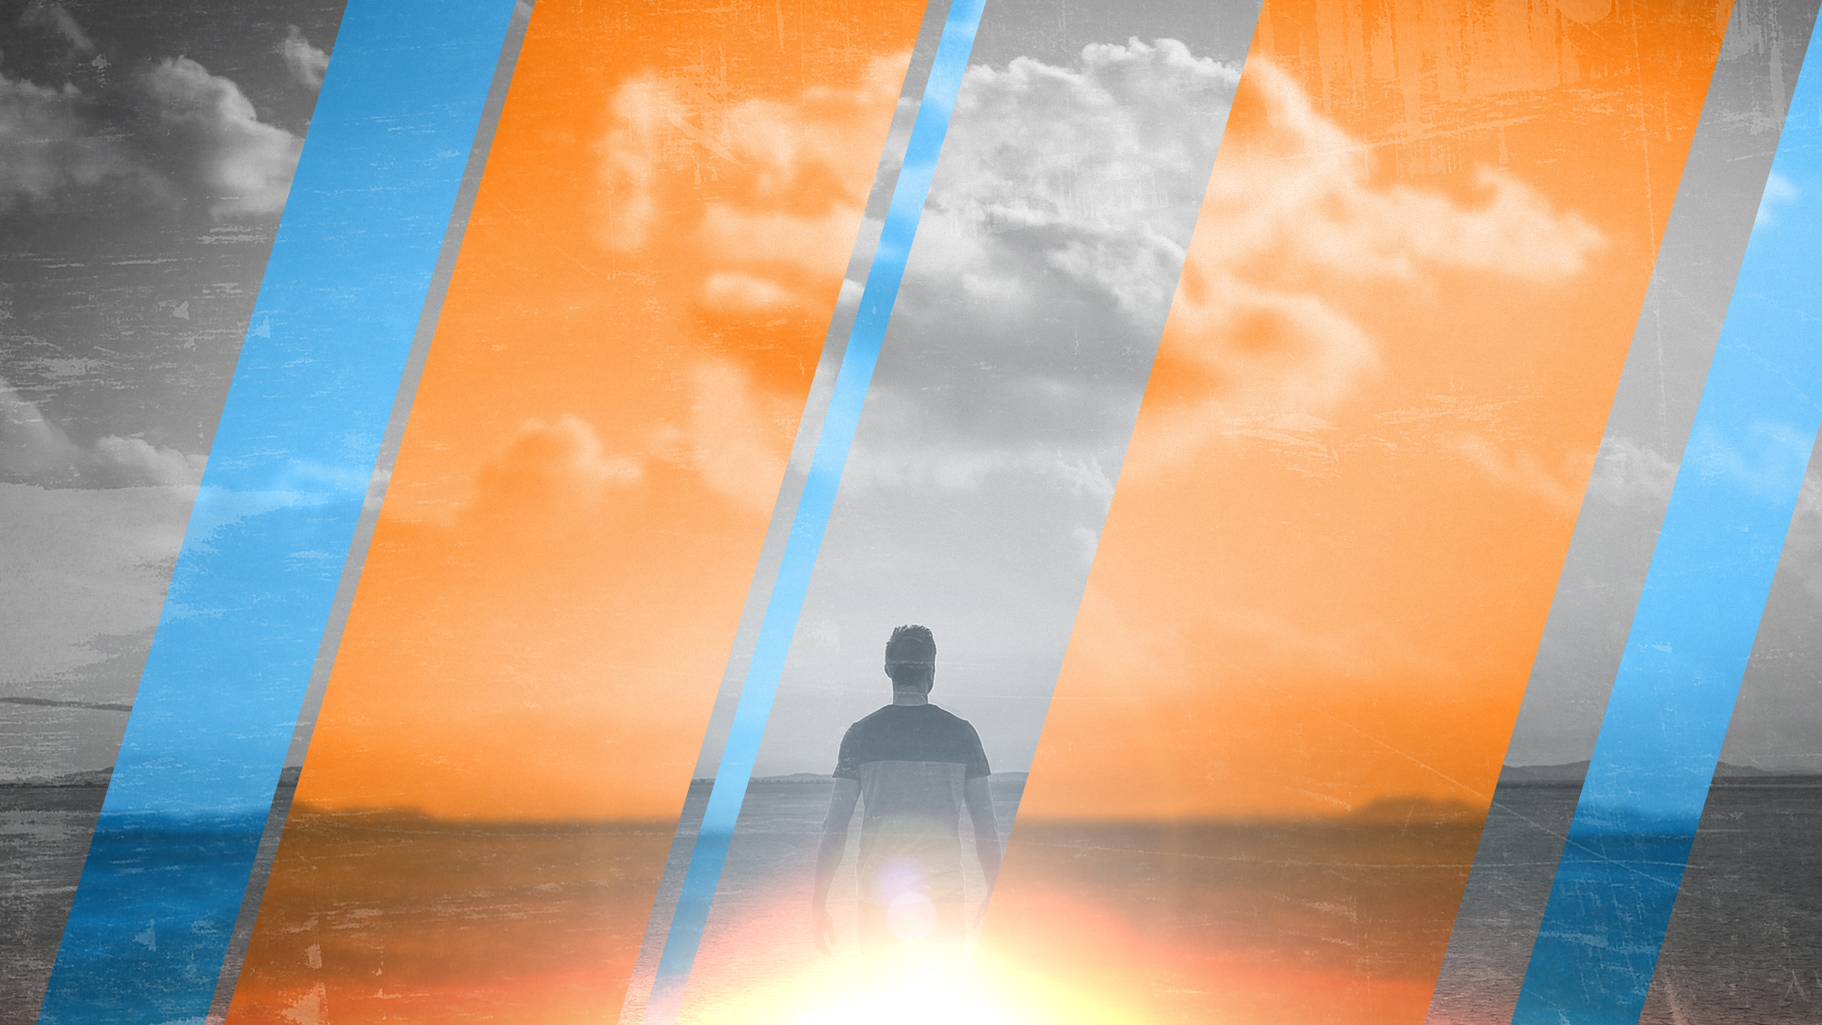
Any nation can be the agent of God's judgment. In the case of Sodom and Gomorrah, God delivered his judgment unmediated. That is why the narrative acquires such proverbial force as a symbol of the naked wrath of God, which reaches its biblical climax, of course, in the book of Revelation. However, in the more normal course of history, God uses one nation or another as the instrument of his sovereign justice.
The classic first instance of this in the Bible is the way the conquest of the Canaanites by the tribes of Israel is repeatedly interpreted as the outworking of YHWH'S judgment on a society whose "iniquity was Full" (a condition they had not yet reached when God predicted it to Abraham in [Gen 15:16].
Wright, Christopher J. H. (2006). The Mission of God: Unlocking the Bible’s grand narrative. Pg 459. Nottingham, England: IVP.

Slide 6
Judges 13:1-5
In those days a man named Manoah from the tribe of Dan lived in the town of Zorah. His wife was unable to become pregnant, and they had no children.
³ The angel of the Lord appeared to Manoah’s wife and said, “Even though you have been unable to have children, you will soon become pregnant and give birth to a son.
⁴ So be careful; you must not drink wine or any other alcoholic drink nor eat any forbidden food.
⁵ You will become pregnant and give birth to a son, and his hair must never be cut. For he will be dedicated to God as a Nazirite from birth. He will begin to rescue Israel from the Philistines.”

Slide 7
The son promised to Manoah's wife would be a Nazirite (a word meaning "dedicated" or "consecrated").
According to Numbers 6:1-12, the Nazirite vow was voluntarily taken for a limited time, but Samson's was lifelong.
Nazirites had three special restrictions:
they were to abstain totally from "fermented drink" and could not eat any grapes or raisins;
(2) they could not have their hair cut; and
(3) they could not come near a corpse.
Violation of all these plays an important part in Samson's life, though the second restriction is particularly emphasized.

Slide 8
It is important to remember this was God’s doing
God was going to rescue Israel
He would do it in spite of how Samson performed
This was the sovereign God at work
We don’t always understand how or why God works in the ways he does.
Faith is about trusting God!

Slide 9
Sometimes Bible stories are embarrassing, nasty, or shocking.
We may be tempted to explain them away or to show why it was not really as bad as it seemed.
Don't do that.
God tells it as it really is in this world.
People are sinners and can do things that are desperately wicked and depraved.
The marvel of the Bible is that God continues to work with and through even fallen, sinful people.
And in the end God accomplishes his purpose—in spite of all the problems we caused.
Wright Christopher J. H. (2016). How to Preach & Teach the Old Testament for all its Worth. Pg 128. Grand Rapids, MI: Zondervan.

Slide 10
When her son was born, she named him Samson. And the Lord blessed him as he grew up. 25
And the Spirit of the Lord began to stir him while he lived in Mahaneh-dan, which is located between the towns of Zorah and Eshtaol. [Judges 13:24]
The Lord blessed him
The Spirit of the Lord began to stir him
It is important that we understand that all of this is God’s means to the end of rescuing Israel.
It is not about Samson but Samson makes it about himself!

Slide 11
Samson very quickly goes off the rails
Judges 14:1:3
He finds a Philistine women that caught his eye
He wants to marry her
His parents object
He told his father get her for me! She looks good to me.
His father and mother didn’t realise the Lord was at work in this, creating an opportunity to work against the Philistines, who ruled over Israel at that time. [Vs 4]

Slide 12
Judges 14:5-9
A lion attacks Samson – the Spirit of the Lord came powerfully upon him [vs 5]
But he didn’t tell his father or mother about it
He later finds the carcase of the lion – scooped honey into his hands and ate it along the way. He also gave some to his father and mother, and they ate it. But he didn’t tell them he had taken the honey from the carcass of the lion. [8-9]
He has broken the vow of a Nazirite- As a Nazirite he must not touch a dead body.

Slide 13
Judges 14:10-19
His father throws a party as final arrangements are being made.
A Feast was literally a place of drinking.
He has broken the vow of a Nazirite- As a Nazirite he must not drink alcohol.
It is at this point Samson begins to play with fire. He tells a riddle and the young men prevail upon his wife to have Samson reveal the answer.
This was the slippery slide. Samson was playing a game but it would eventually lead to his downfall.
The game ends with the Spirit of the Lord coming powerfully upon him.[Vs19] In the process he kills thirty men and loses his wife.

Slide 14
Judges 15:1-17
He decides he will go and get his wife back but she has been given in marriage to his best man! The father has concluded that he has divorced her. He offers his younger daughter instead.
Samson decides to take revenge. He burns their grain harvest, their vineyards and olive groves in a very novel way
The Philistines burned the former wife and her father to death.
Samson takes revenge by killing many of them.
The Philistines attack Judah
The men of Judah hand him over to the Philistines
The Spirit of the Lord came powerfully upon Samson and he kills a 1000 men with the jawbone of an ass – and boasts about it [Vs 14-17].

Slide 15
Judges 15:18-20
Samson is now thirsty and cries out the Lord…
So God caused water to gush out of a hollow in the ground at Lehi
Samson was revived as he drank
Chapter 15 ends by stating Samson judged Israel for twenty years in the period when the Philistines dominated the land.

Slide 16
Judges 16:1-3
He goes to spend the night with a prostitute
The Philistines see this as an opportunity to kill him.
But at midnight he gets up and picks up the doors of the town gate as well as the posts and carries them away. These would have weighted about 200 kilograms and he carried them some distance. Gaza to Hebron is 40 kilometres. He possibly deposited the gates on top of a hill overlooking Gaza.

Slide 17
Judges 16:4-22
Some time later! Samson falls in love with Delilah – she lived near Samson’s hometown – probably a Philistine it does not say.
She is offered from each of the five rulers 1100 shekels of silver + 5500 shekels equivalent to 550 years wages.
She starts to get out of Samson the secret of his strength
It is here that Samson’s downfall begins – he has toyed with where his strength comes from and each secret he shares moves closer and closer to the fact that his hair has never been cut. It is cut and Samson thinks all will be the same.
But he didn’t realise the Lord had left him [Vs 20c].

Slide 18
Judges 16:23-30a
The Philistine rulers held a great feast
They bring out Samson for amusement
Samson asks the young servant leading him to place his hands against the pillars
Here is the man who was used to doing everything in his own strength needing someone to guide him
Then Samson prayed to the Lord
Sovereign Lord, remember me again
Oh God, please strengthen me just one more time
he prayed, “Let me die with the Philistines”

Slide 19
Judges 16:30b
And the temple crashed down on the Philistine rulers and all the people. So he killed more people when he died than he had during his entire lifetime.
Samson had finally realised his strength came from the Lord

Slide 20
God has Called all of us to a life of Faith
Some he has called to a specific ministry – in Samson’s case God wanted to deal with the Philistines
We must all realise that it is not our strength that counts
We have been given the Holy Spirit to help us fulfil that to which we are called
Some have forgotten this principle and used the gifts and talents for their own benefit
And like Samson their strength will fail them

Slide 21
God has Called all of us to a life of Faith
Hebrews 12:1-2
Therefore, since we are surrounded by such a huge crowd of witnesses to the life of faith, let us strip off every weight that slows us down, especially the sin that so easily trips us up.
And let us run with endurance the race God has set before us. 2
We do this by keeping our eyes on Jesus, the champion who initiates and perfects our faith.
Because of the joy awaiting him, he endured the cross, disregarding its shame. Now he is seated in the place of honor beside God’s throne.

